Slide 1

Restaurant website
Andrea Monica Chiu
April 20, 2021
Notes:
Line spacing + Page numbers

Slide 2
Content
01 Objective
02 Concept
03 Sample Mock Up Design

Slide 3
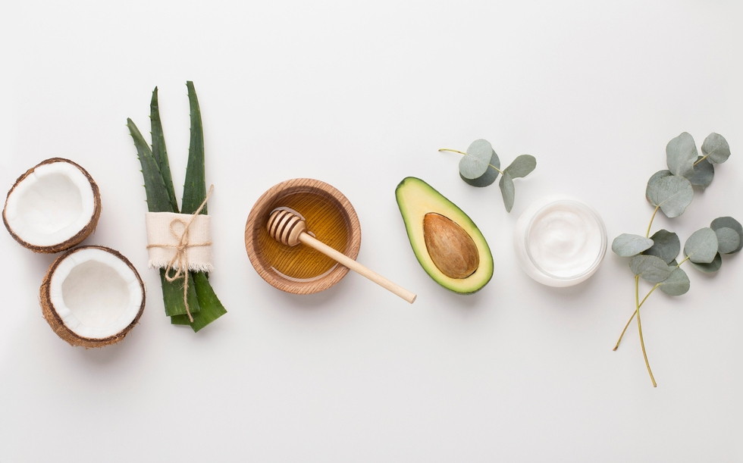


Objective:
01
to let people to feel the vibe of the restaurant upon opening the website
To let the user easily browse the website
To let the user to book reservation and order online

Slide 4
Sample mock up design
03

Slide 5
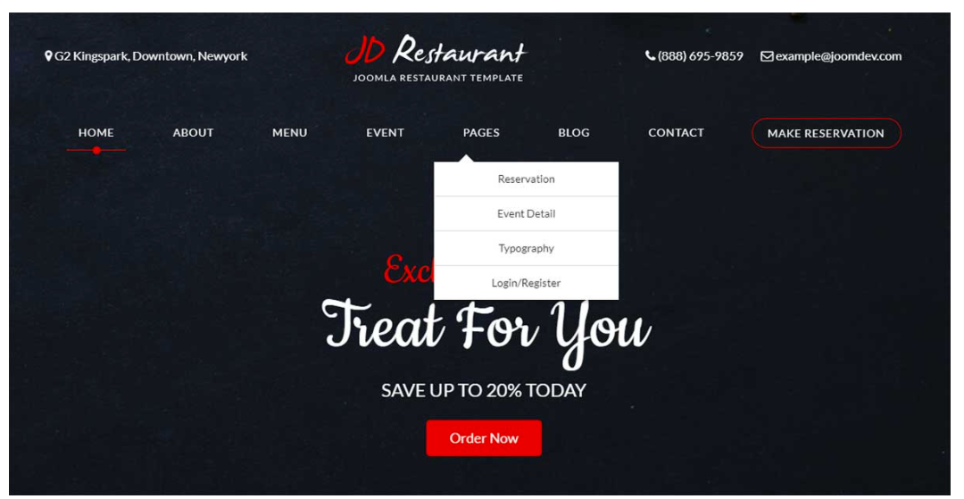
home page

Slide 6
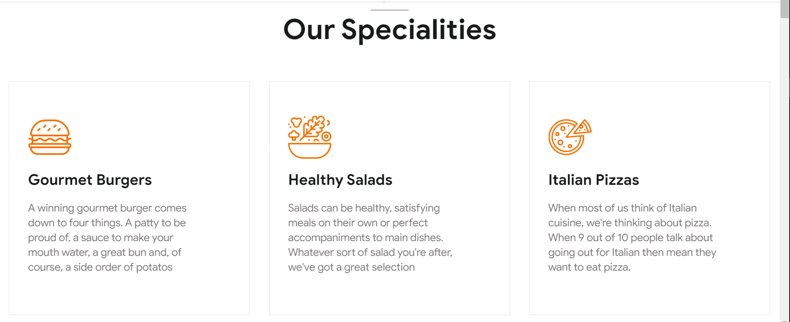
Menu page

Slide 7
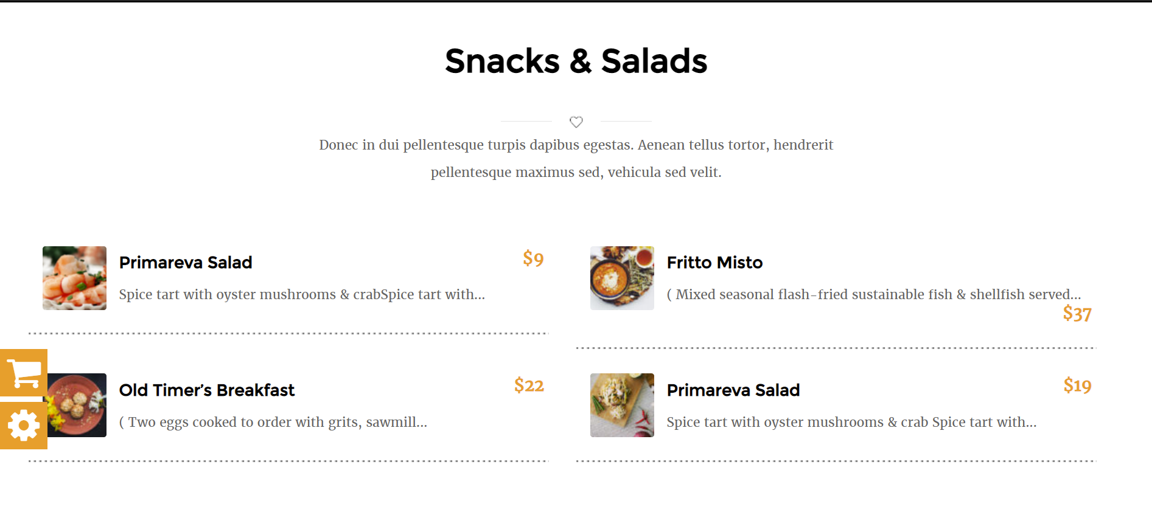
Menu page

Slide 8
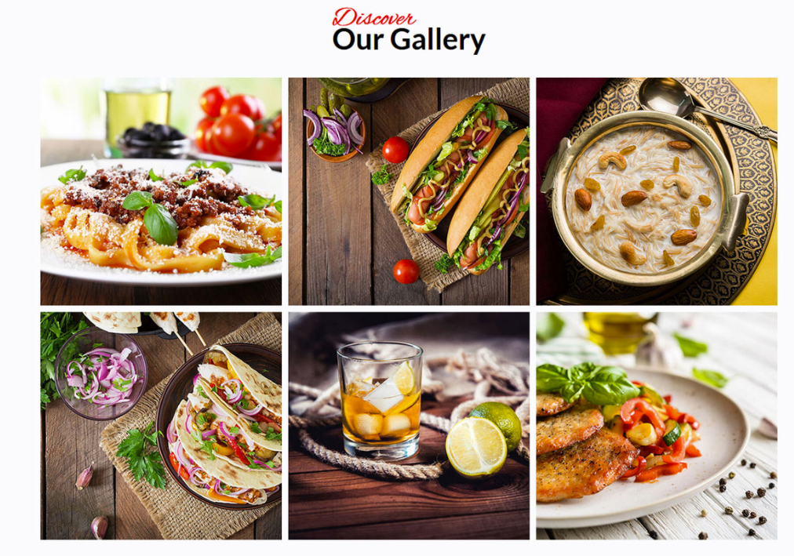
Gallery section

Slide 9
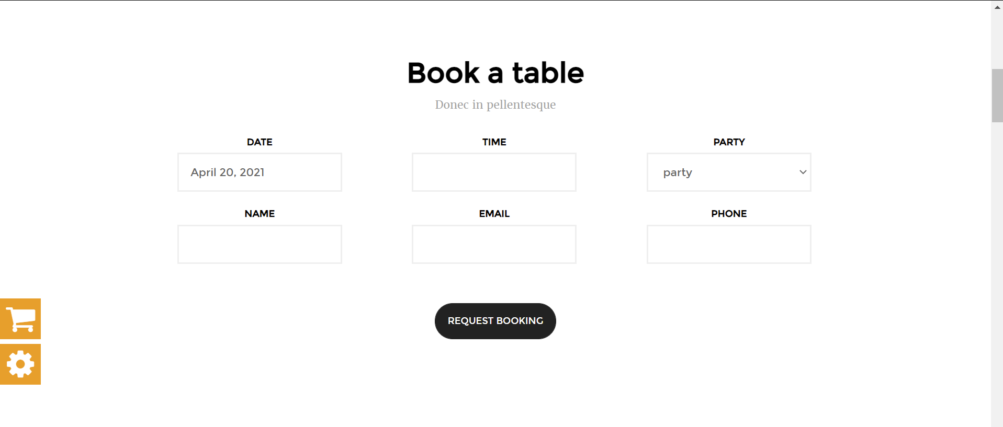
reservation

Slide 10
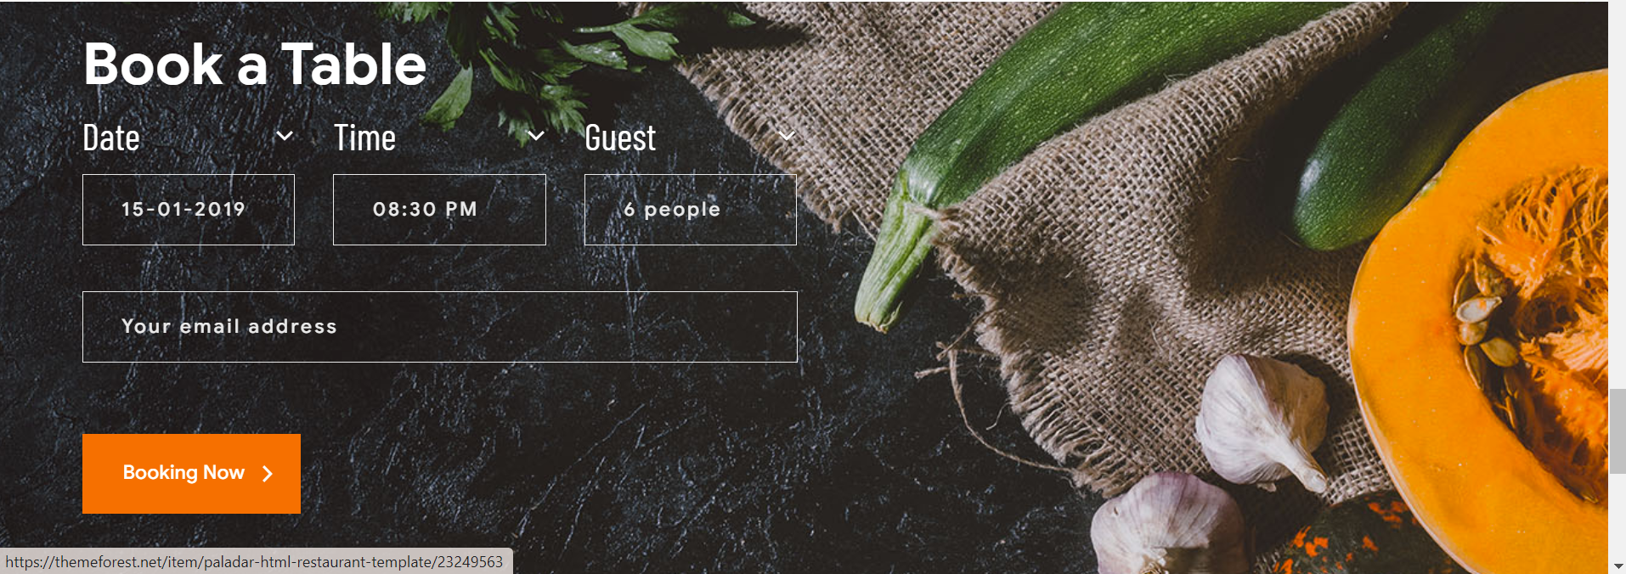

Slide 11
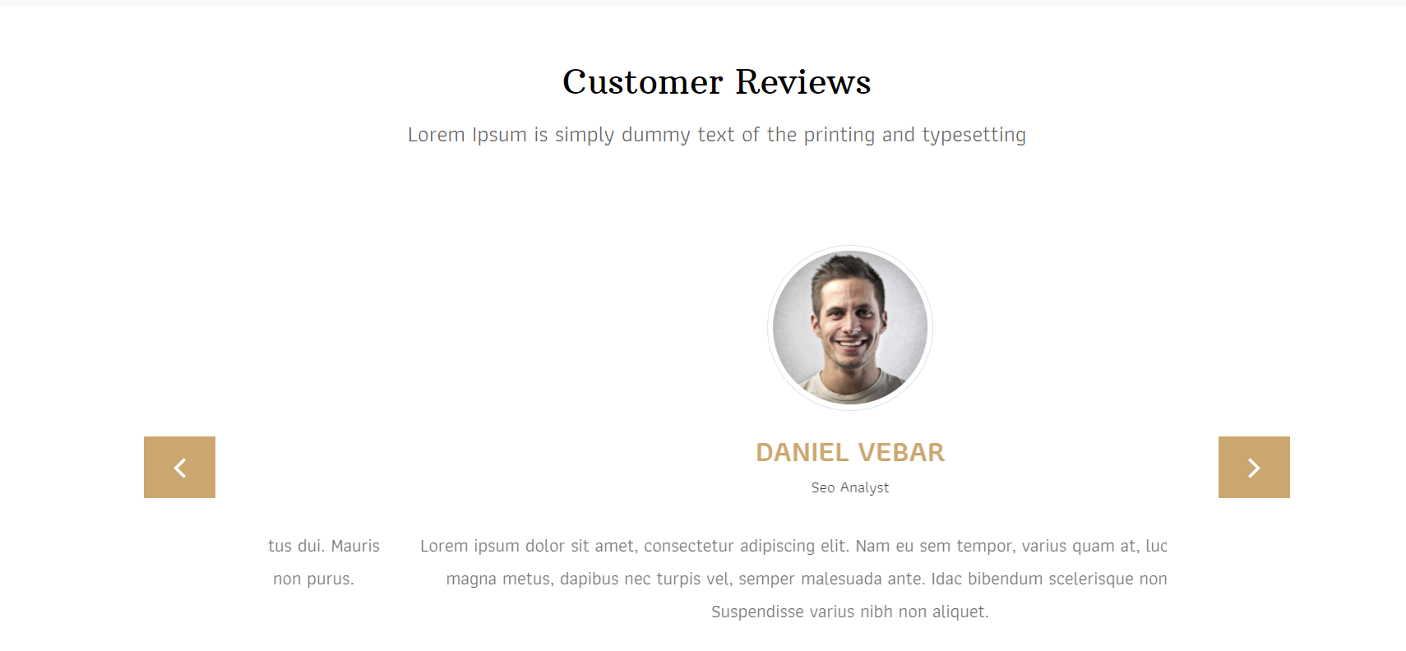
Customer review

Slide 12
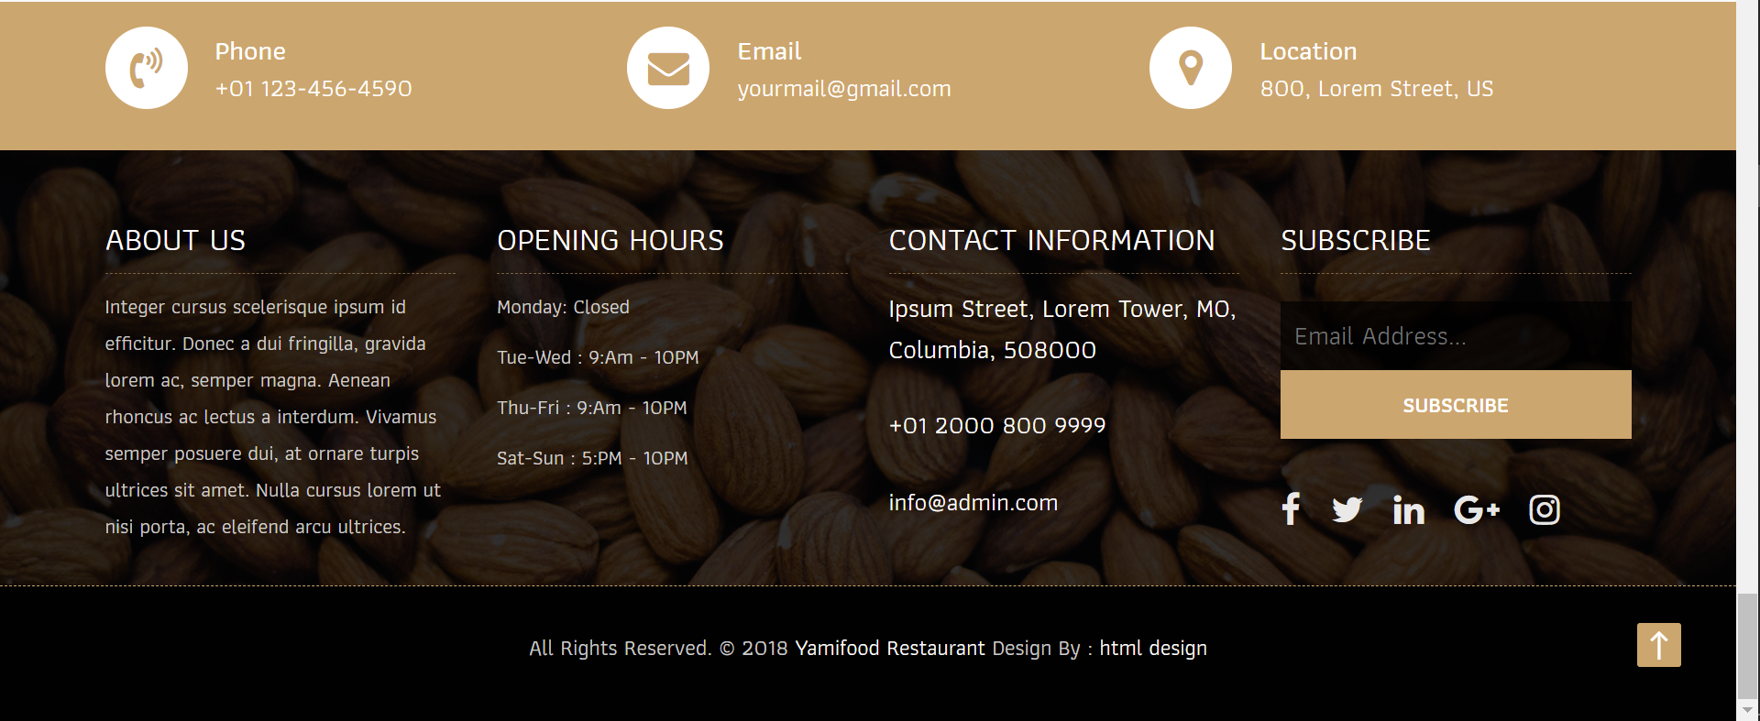
footer

